Slide 1

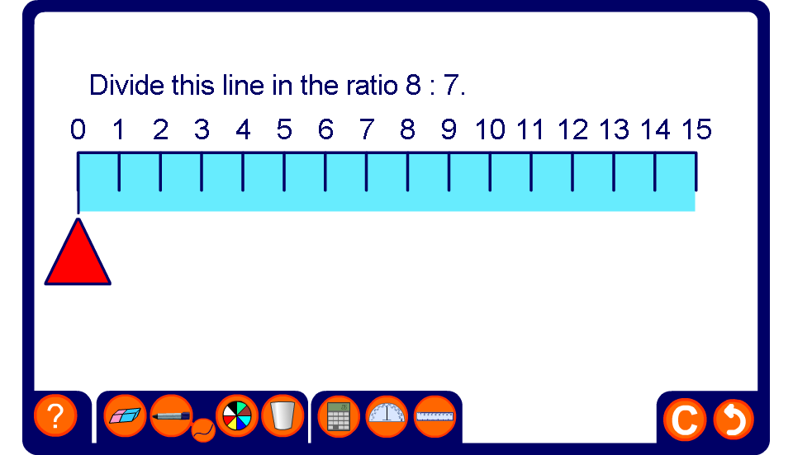


Dividing a length in a given ratio
Notes:
Use this activity to revise how a quantity can be divided into a given ratio. Ask a volunteer to come to the board to demonstrate the required solution. Ask them to justify their reasoning before revealing the solution.
Establish that we can add together the parts of the ratio to find the total number of parts. The length of the line can be divided by the total number of parts in the ratio to find the length of each part. The length of each part is then multiplied by the number of parts on each side of the ratio.

